Slide 1
Community of Practice
Inception Workshop
Strengthening Civil Society and Civil Servant Capacity in Belize through Partnership”
September 2019
Dr. Kathleen Earl Colverson, University of Florida

Slide 2
What is a “Community of Practice”?
Communities of practice are groups of people who share a concern or passion for something they do, and learn how to do it better as they interact regularly

Slide 3
Community of Practice (CoP)
Members of a community of practice are practitioners
It is not just a club of friends or a network of connections between people. It has an identity defined by a shared domain of interest
Members engage in joint activities and discussions, help each other, and share information
They develop a shared repertoire of resources: experiences, stories, tools, ways of addressing recurring problems together

Slide 4
A Community of Practice is a place where…
• Emphasis is on learning, developing new ideas and strategies. Learning
• Group formation tends to be spontaneous. Spontaneous
• Activity happens around a set of shared problems. Shared Problems
• Members act as sounding boards for new ideas & help each other. Mutual Engagement
• CoP chooses members, and members choose whether to participate or not. Reciprocal Process
• People who may never come in contact are otherwise connected. Connected
• Knowledge about specific practices flows from individual insights to documented, verified, used best practices—and from location to location. Best-Practice Sharing
• Body of knowledge is collected, connected with members, organized, upgraded, and re-deployed. Knowledge Stewarding
• Boundaries are crossed to generate new ideas. Innovation
(Adapted from Kulkarni, 2000; Gotto IV, 2009, Wenger 1998)

Slide 5
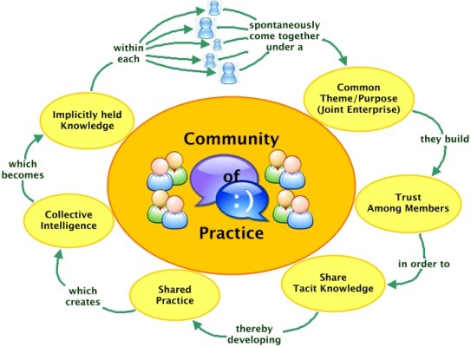

Slide 6
What are our shared values or ideas for working together?
Break into small groups with equal numbers of Civil Servants and Civil Society participants
Brainstorm around “What are our shared ideas for improving communications and working together to enhance services to underserved communities in Belize”?
List top three ideas on flip chart and share with plenary

Slide 7
Prioritizing key ideas for CoP for Belize
Review the top ideas from each group
Clump ideas into themes
Each participant votes with stickers for the top three ideas for the CoP to start work on
Decide who will be the champion for each idea with TIDE

Slide 8
References:
Etienne and Beverly Wenger-Trayner, Communities of Practice
https://wenger-trayner.com/
https://www.knowledge-management-tools.net/communities-of-practice.html
Blankenship, S. Ruona, W. (2007). Professional Learning Communities and Communities of Practice: A Comparison of Models, Literature Review
Gotto IV, G., Turnbull, A., Summers, J. Blue-Banning, M. Community of Practice Development Manual: A Step-by-Step Guide for Designing and Developing a Community of Practice. Accessed May 2014 at: http://www.researchutilization.org/products/copmanual/CoP_Manual.pdf

