Slide 1
Community of Practice
Inception Workshop
Strengthening Civil Society and Civil Servant Capacity in Belize through Partnership”
September 2019
Dr. Kathleen Earl Colverson, University of Florida

Slide 2
What is a “Community of Practice”?
Communities of practice are groups of people who share a concern or passion for something they do, and learn how to do it better as they interact regularly

Slide 3
Community of Practice (CoP)
Members of a community of practice are practitioners
It is not just a club of friends or a network of connections between people. It has an identity defined by a shared domain of interest
Members engage in joint activities and discussions, help each other, and share information
They develop a shared repertoire of resources: experiences, stories, tools, ways of addressing recurring problems together

Slide 4
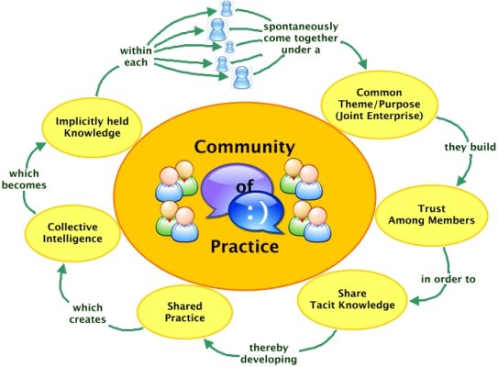

Slide 5
What are our shared values or ideas for working together?
Break into small groups with equal numbers of Civil Servants and Civil Society participants
Brainstorm around “What are our shared ideas for working together to enhance services to underserved communities in Belize”?
List all ideas on flip chart and share with plenary

Slide 6
Prioritizing key ideas for CoP for Belize
Review the top ideas from each group
Clump ideas into themes
Prioritize the top three ideas for the CoP to start work on
Discuss what’s possible and how it might get done

Slide 7
References:
Etienne and Beverly Wenger-Trayner, Communities of Practice
https://wenger-trayner.com/
https://www.knowledge-management-tools.net/communities-of-practice.html
Blankenship, S. Ruona, W. (2007). Professional Learning Communities and Communities of Practice: A Comparison of Models, Literature Review
Gotto IV, G., Turnbull, A., Summers, J. Blue-Banning, M. Community of Practice Development Manual: A Step-by-Step Guide for Designing and Developing a Community of Practice. Accessed May 2014 at: http://www.researchutilization.org/products/copmanual/CoP_Manual.pdf

